Slide 1
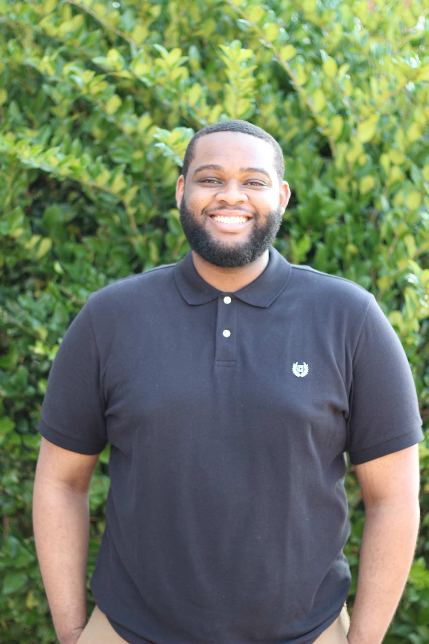
Marcus Castille Jr.
Computer Science
- May 2020 Graduation

Slide 2
Itinerary
Who am I?
Prior Experience
Industry Knowledge
Traits
Future Goals

Slide 3




Who is Marcus?
New Orleans, LA ✈ Baton Rouge, LA
Louisiana Tech University
Why computer science?

Slide 4

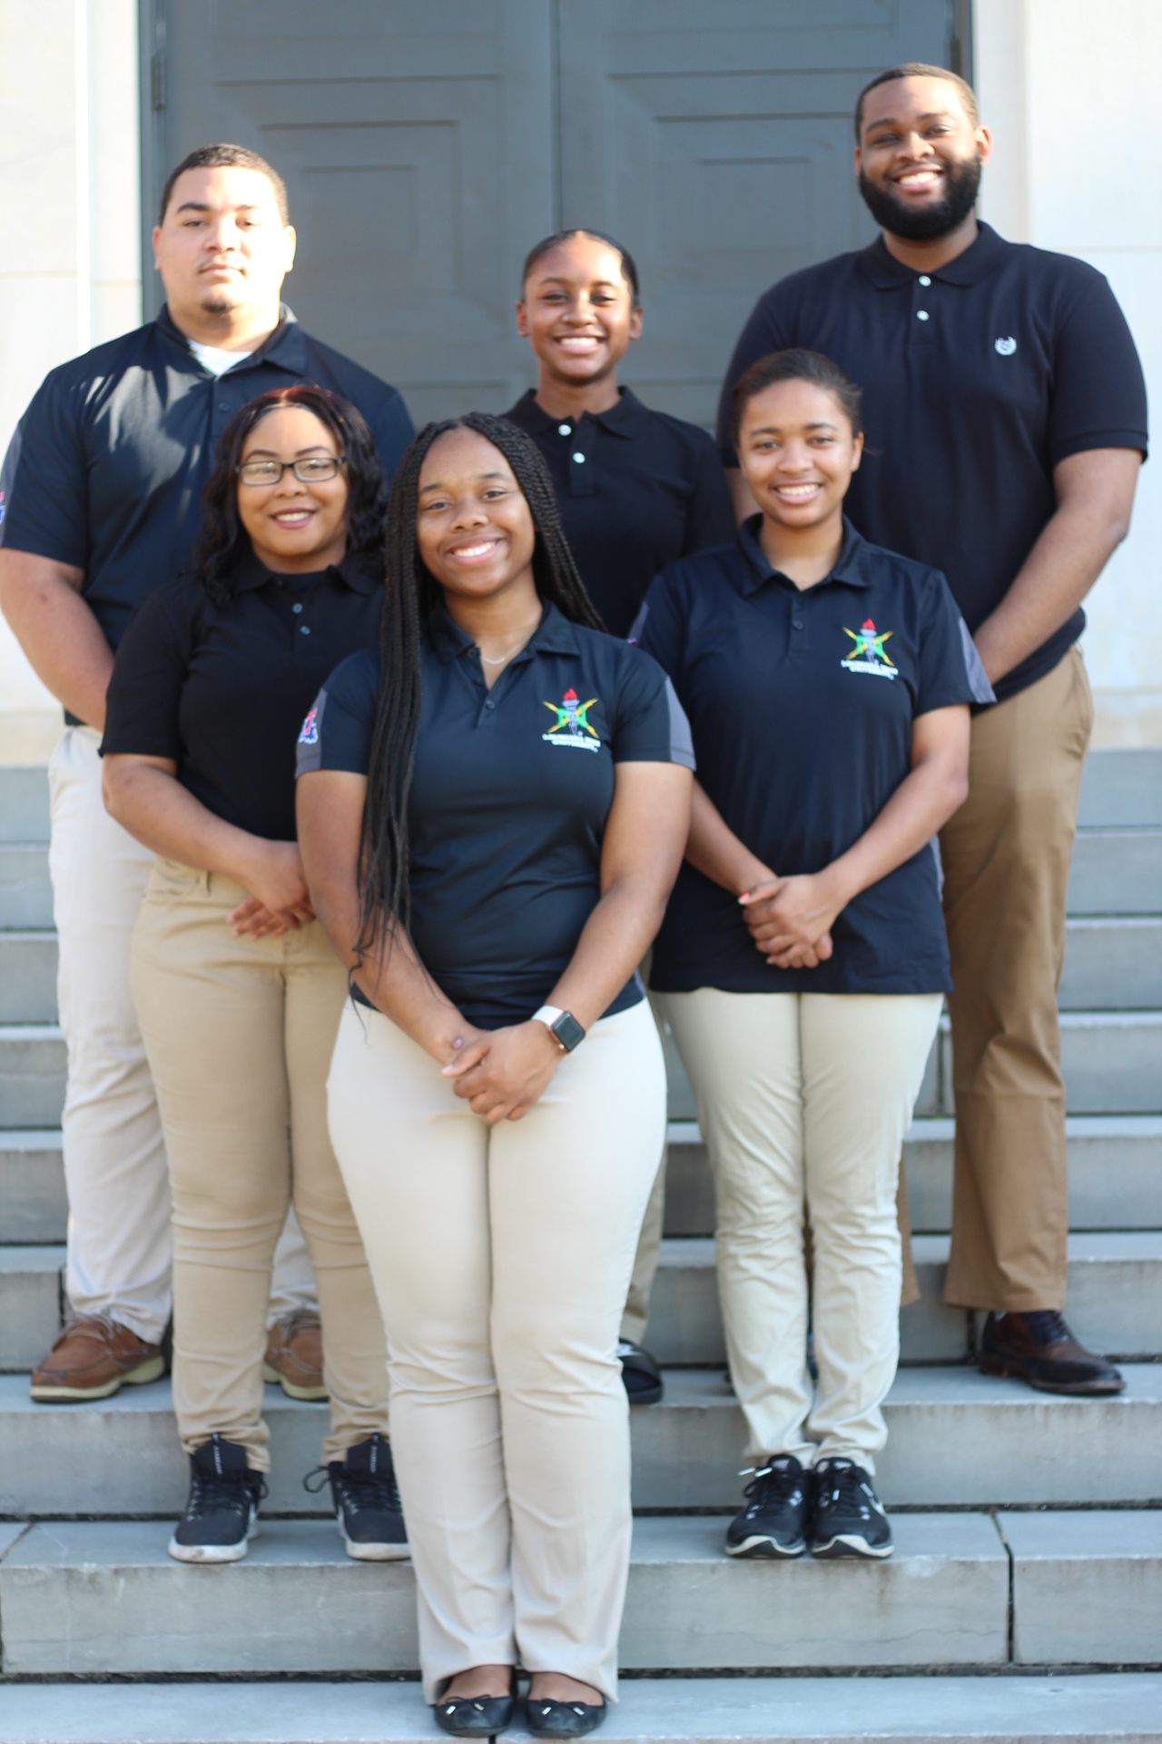


Experience
The Recognition Company (Feb. 2017 – Dec. 2017)
Basic Web Design
WordPress
HTML
CSS
National Society of Black Engineers (May 2019 – Present)
2019 – 2020 NET Chair
JavaScript
Python
Fenway Group (March 2018 – Present)
Software Developer
Java
Spring
C#

Slide 5






Tools and Technologies
React JS | Spring | Gradle | Tomcat | git | AWS

Slide 6

Behavior Characteristics
Assist Teammates
Effective Demos
Communication Skills
Lead meetings
(Ex. Daily Scrum, Planning Meetings)

Slide 7

Goals
Become a tech lead
Learn web assembly
Make code more dynamic
Be better than I was yesterday

Slide 8
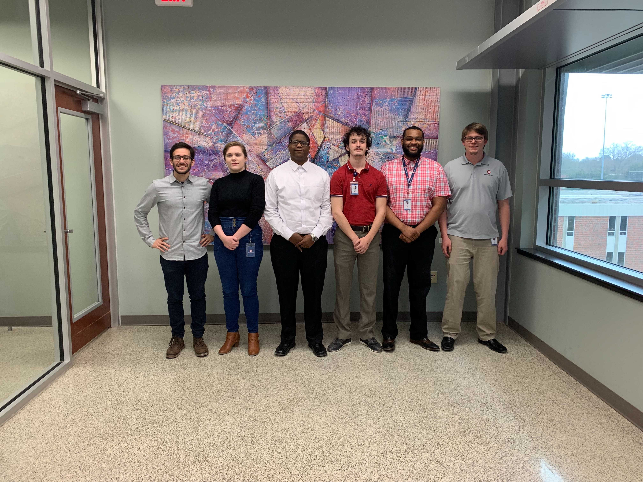
Conclusion
Experience in the industry
Adapt to new scenarios quickly
Passionate about sharing knowledge and learning

